Slide 1


CLD6001:Contemporary Problem Analysis
Title: Populating Large Databases
with Realistic Data.
By
Supervisor: Dr Giorgos Prokopakis
Student name: Matthaios Chatzimichail

Slide 2
Contents
Contents.
Project Definition.
Fake Data Generation.
Relational Database Systems.
The Database Schema.
Populating the Database.
The Executed Queries.
Conclusion.
References.

Slide 3
Project Definition.
The problem that had to be analyzed and solved for this project was the issue of populating large databases with realistic data.
Populating the database with a large amount of realistic data can be an integral action in our quest of identifying potential problems with the design of the database and testing the database’s functionality.
The solution will consist of a database that will be designed and implemented to serve a large scale online store, platform and it will be populated efficiently with realistic fake data.

Slide 4
Fake Data Generation.
- Synthetic or fake data is information that is produced artificially or through simulation as opposed to coming from real-world occurrences.
The statistical characteristics of the original dataset are mirrored in a synthetic dataset by modeling it after real data.
The use of fake data produces more effectively accessible datasets.
Synthetic datasets do not classify as identifiable personal information.
Therefore, individual consent would not be required to use these datasets for different purposes in contrast with authentic datasets.

Slide 5
Relational Database Systems.
- The database is a single, potentially sizable data repository that numerous departments and users can access at once.
The Database represents the logical relationships between entities, and their attributes.
A database's contents must be accurate, comprehensive, and arranged so that they can be retrieved in the desired format and at the appropriate time.

Slide 6
Relational Database Systems.
An entity is an object within the database, that can store data, and usually refers to a table that contains attributes.
A property that characterizes an aspect of the object that we want to document is called an attribute.
A relationship is the connection between two entities.
The basis for all database systems is the relationships between elements in the database environment.

Slide 7
The Database Schema.
The design of the database schema is the most vital component of every functional database.
The schema for this project is designed to emulate the structure of an online store platform’s database.
Although the database’s size of such a platform will be considerably larger, the schema designed for this project can serve as a solid base for an online store database.
The schema for this online store platform was constructed in MySQL Workbench

Slide 8
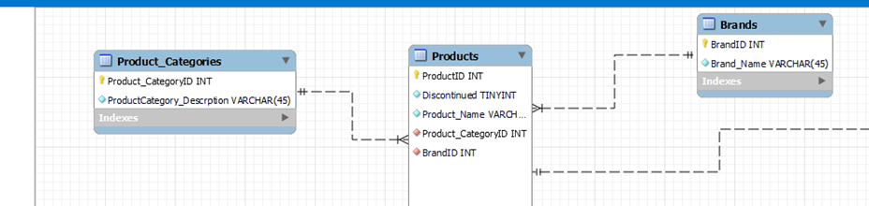
The Database Schema.
- The first functionality offered by the system in this case is the ability of the user to select products based on the brand and/or category they are in and also view all the products in a specific category or brand.

Slide 9
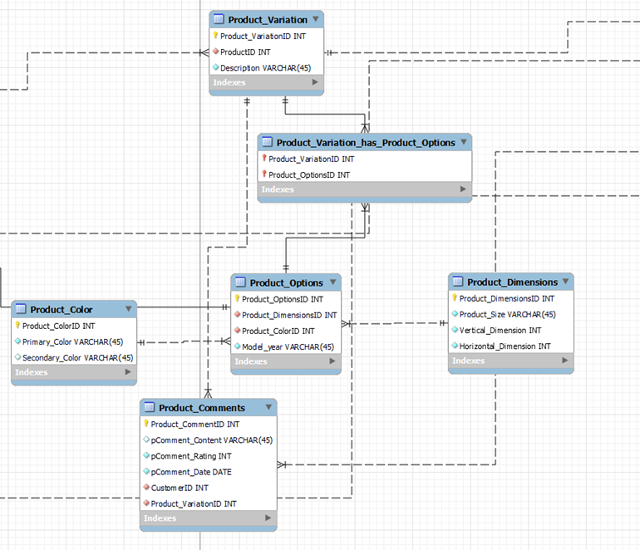
The Database Schema.
- The second functionality offered by the system based on this part of the schema is the ability to select a product based on a specific version of it or based on one or more characteristics more specifically. Furthermore, the user can also view all the products that share the same one or more characteristics. Additionally, the user is able to make a comment on a specific version of a product.

Slide 10
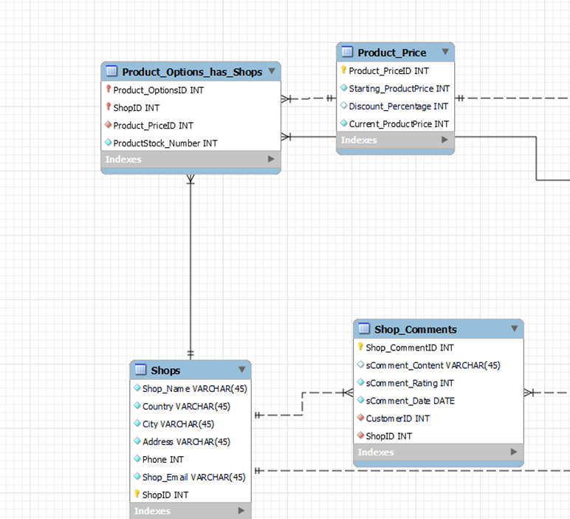
The Database Schema.
- The third functionality offered by the system from this part of the schema is the ability to view the products of each shop as well as the price set by the shop to each product, furthermore the user can make a comment on a specific shop.

Slide 11
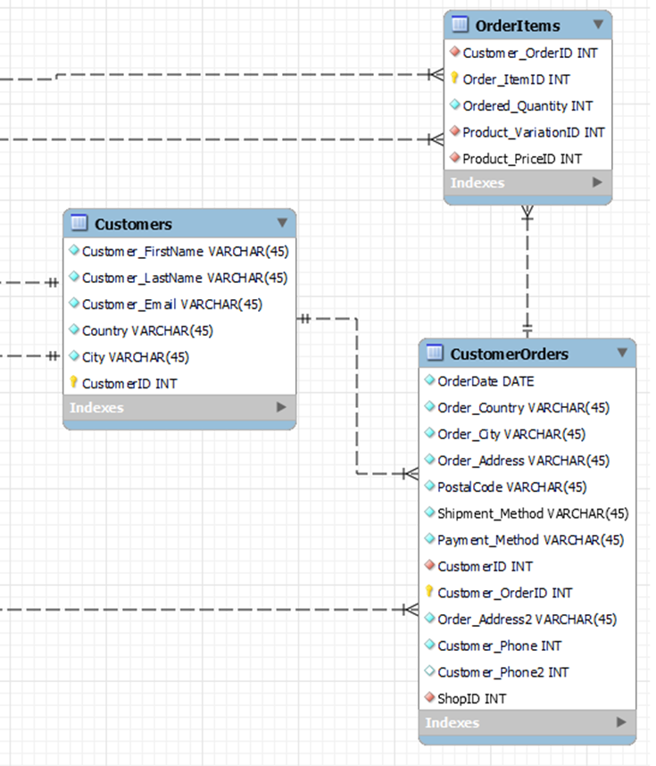
The Database Schema.
- The final functionality offered by the system regarding the orders of the customers is the ability to view the order’s information regarding the shop, the customer, and also the products of the order.

Slide 12
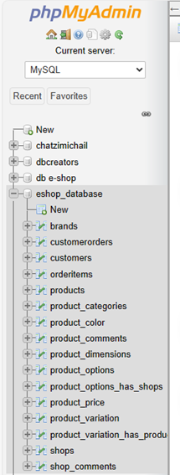
Populating The Database.
- Putting in motion the process of populating the database with realistic data requires us to create a database based on the schema that was showcased above. Therefor the database schema needs to be exported from the MYSQL Workbench application and imported to phpMyAdmin.

Slide 13
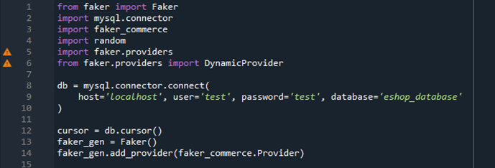
Populating The Database.
After establishing the database we have to connect it with python in order to utilize the built in “faker” library that python possess to populate our database with realistic fake data.
Faker can produce "fake" data that appears realistic by utilizing so-called providers.
Populating the database requires us to import the faker library as well as the faker commerce module that is able to generate commerce and product related entries.
Another python module that has to be imported is the Random module, that defines a series of functions for generating or manipulating random integers.

Slide 14
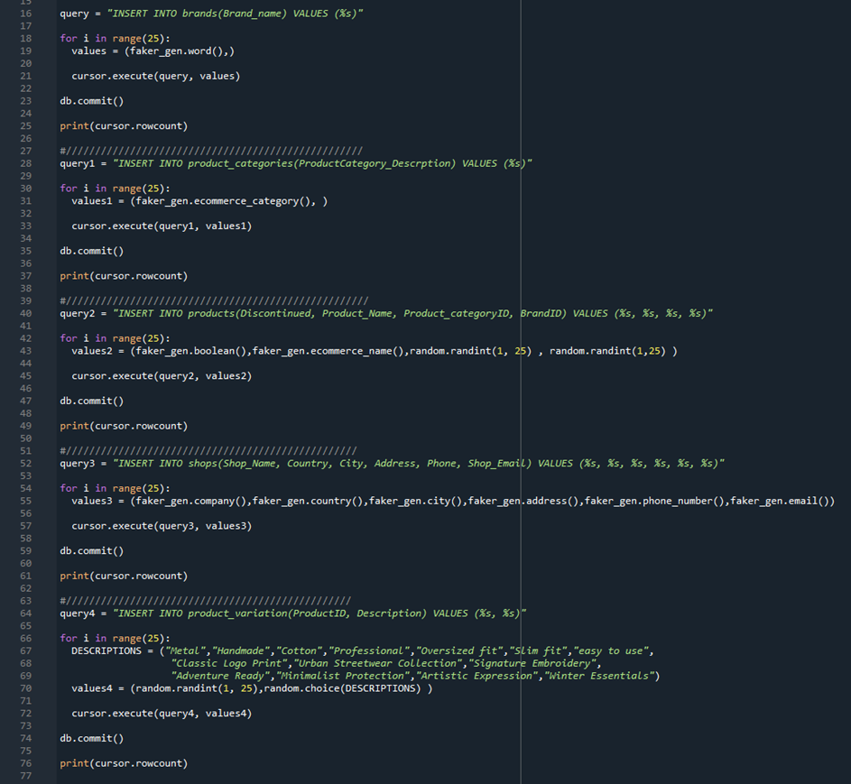
Populating The Database.
- With the correct libraries imported, the next step to populate the database should be to run the “insert” queries for each table of the database.

Slide 15
The Executed Queries.
In order to showcase the functionalities of the system by executing some queries, we utilize small flask applications.
Flask is a compact framework that was created from the ground up to be extensible, it offers a strong core with the essential functions, and extensions handle the rest.
In every query example, an html page is displaying a title and the data in a table form along with the executed query.

Slide 16
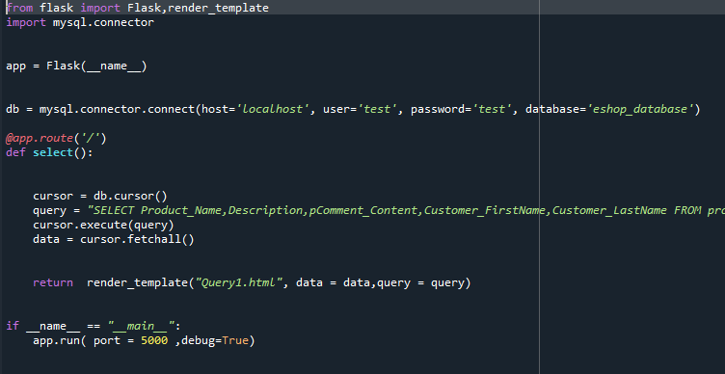
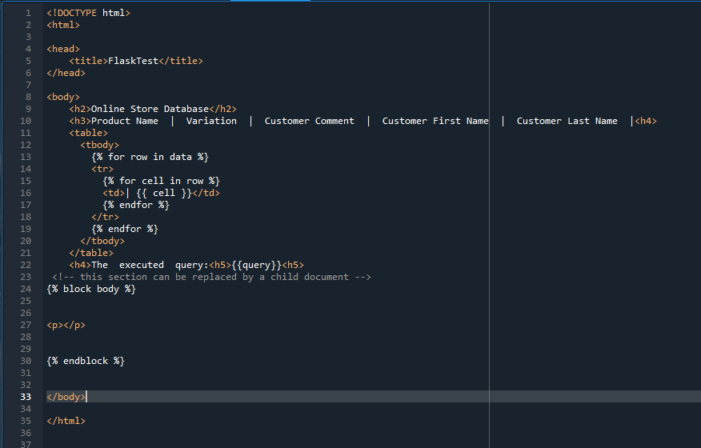
The Executed Queries.
- The Flask application and HTML page code of the first query:

Slide 17
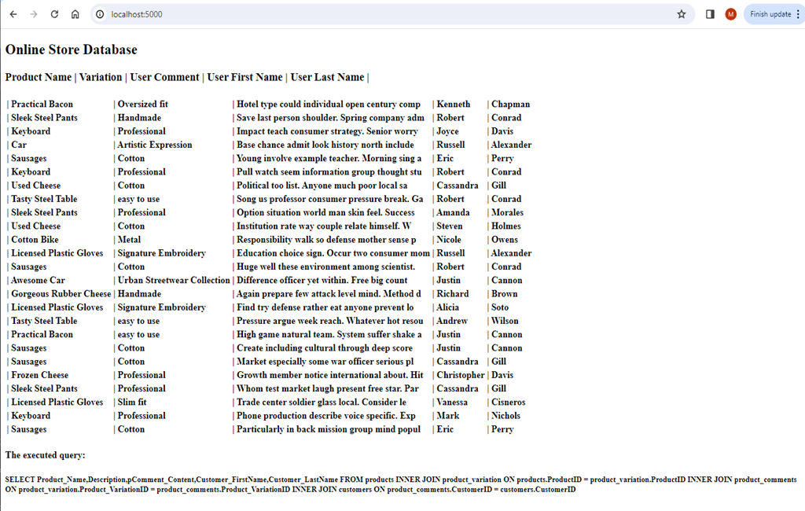
The Executed Queries.
- In the first query example the columns selected are the names of the products, their variations, the customer’s comments on the product variations and the customer’s first and last names.

Slide 18
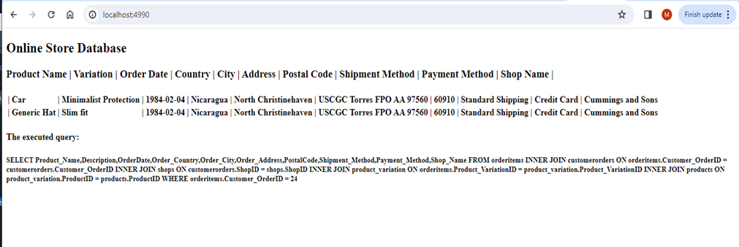
The Executed Queries.
- The second query example showcases a specific order that contains two different items. The columns selected are the names of the products and their variations, the date, city, address, postal code, shipment and payment method of the order and finally the name of the shop.

Slide 19
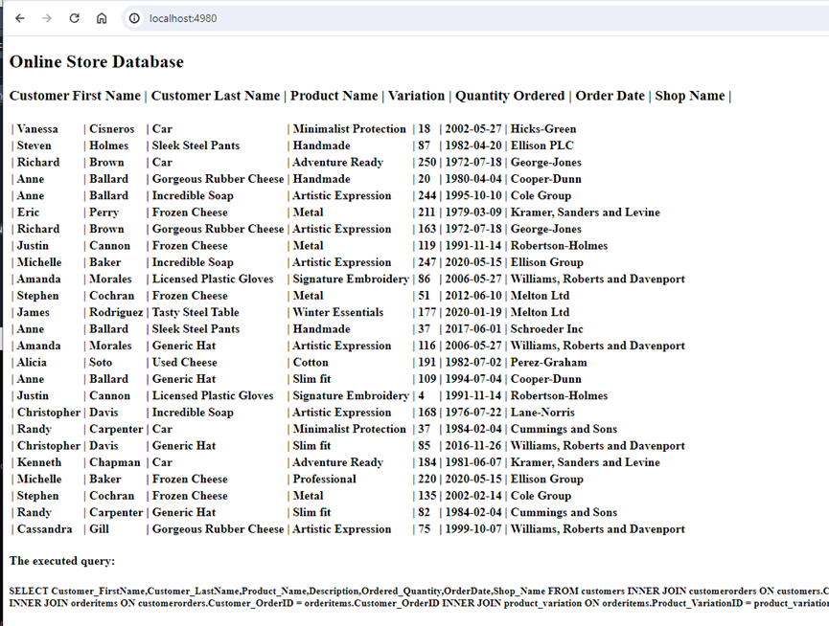
The Executed Queries.
- In the third query example the columns selected are the customers first and last names, the product names and variations, the quantity that was ordered by each customer, the dates of the orders, and the names of the shops.

Slide 20
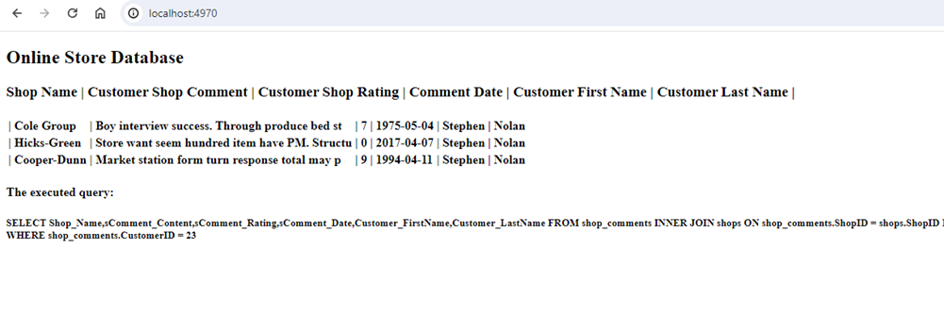
The Executed Queries.
- The fourth query example showcases a specific customer that has made three comments on three different shops. The columns selected are the names of the shops, the content of the comments, the ratings and the dates of the comments, the first and last name of the customer.

Slide 21
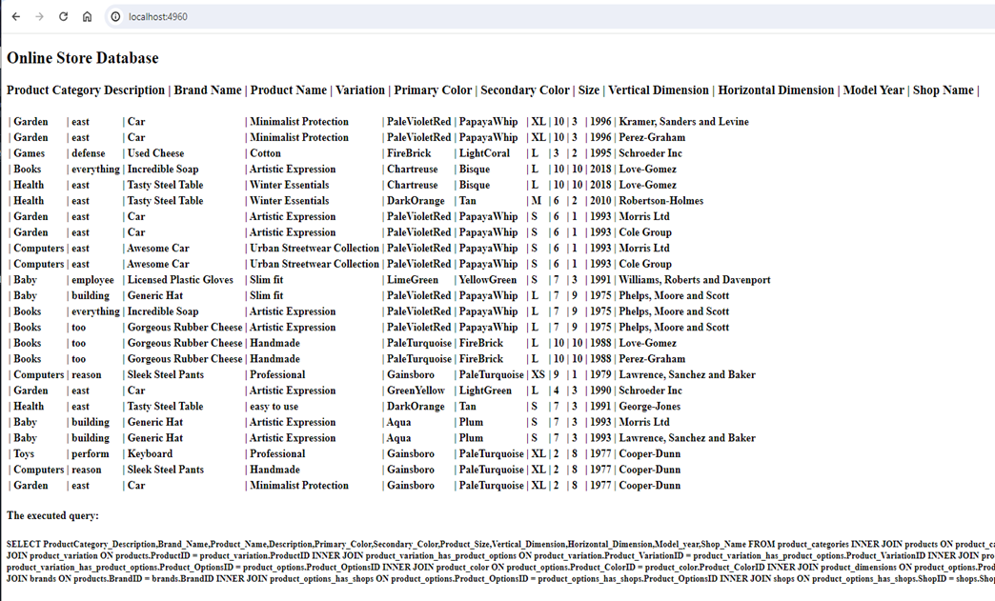
The Executed Queries.
- The fifth query example displays the names of the products along with the names of their categories, brands, variations, primary and secondary colors, sizes, vertical and horizontal dimensions, model years, as well as the names of the shops that can provide them.

Slide 22
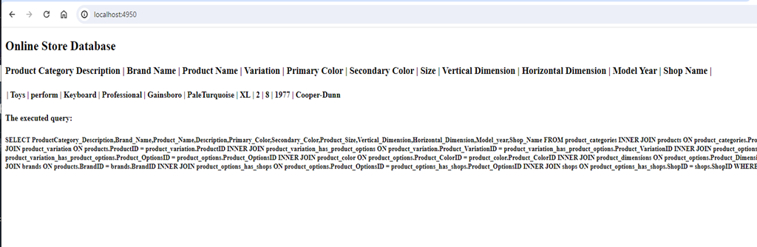
The Executed Queries.
- The final query example displays the category, brand, variation, primary and secondary color, size, vertical and horizontal dimension, model year, of the product “Keyboard” as well as the name of the shop that can provide it.

Slide 23
Conclusion.
Populating large scale databases with realistic data can prove to be a very complicated task.
The success of such a project is heavily depended on an efficient and functional database.
The generation of fake realistic data can be achieved by many different approaches, nonetheless python through its faker and random libraries can accommodate such a task in great capacity.

Slide 24
References.
1.) Dankar, F.K. and Ibrahim, M., 2021. Fake it till you make it: Guidelines for effective synthetic data generation. Applied Sciences, 11(5), p.2158.
2.) James, S., Harbron, C., Branson, J. and Sundler, M., 2021. Synthetic data use: exploring use cases to optimise data utility. Discover Artificial Intelligence, 1(1), p.15.
3.) Connolly, T.M. and Begg, C.E., 2005. Database systems: a practical approach to design, implementation, and management. Pearson Education.
4.) Harrington, J.L., 2016. Relational database design and implementation. Morgan Kaufmann.
5.) Carrola, A., 2022. Synthesizing Realistic Substitute Data for a Law Enforcement Database using a Python Library. West Virginia University.
6.) Grinberg, M., 2018. Flask web development: developing web applications with python. " O'Reilly Media, Inc.".
7.) Ghimire, D., 2020. Comparative study on Python web frameworks: Flask and Django.
8.) El Emam, K., Mosquera, L. and Hoptroff, R., 2020. Practical synthetic data generation: balancing privacy and the broad availability of data. O'Reilly Media.

